Slide 1
Technology Infrastructure for E-commerce
UNIT II

Slide 2
UNIT II: Technology Infrastructure for E-commerce
E-Commerce Infrastructure:
Key Technology Concepts,
Limitations of the Current Internet, the Future Internet.
Building an E-commerce Presence:
Systematic Approach,
Simple versus Multi-tiered Web Site Architecture,
Tools for Interactivity and Active Content.

Slide 3
Assignment 1
1.Describe in detail eight Unique Features of E-commerce Technology.
2.Illutrate the eight Key Elements of a Business Model.
3.Discuss the key technology concepts for an ecommerce ecosystem.
4.What are the current limitation on the internet. Suggest any two techniques to overcome these limitations.
5.Discuss various Digital Commerce Marketing and Advertising Strategies and Tools.

Slide 4
E commerce –Technology Road Map
First Gen – Tele call, Tele Vision, Radio etc.
Second Gen – Desktop + Internet
Third Gen – Mobile + Internet
Fourth Gen – Social networking apps + internet
Fifth Gen- Wearable devices + AR/VR + Google glass+ IoT ( Future Internet)

Slide 5
Internet History
1961-The idea of Packet switching
1969-ARPANET( Defence)
1972- e-mail
1980- TCP/IP, PC Invented
1989 – HTML is standardized
1990- Internet open to public Through NSF
1993- first Web Browser –Mosaic
1994- Netscape Web Browser
1995- Amazon, ebay

Slide 6
Circuit Switching and Packet Switching
Prior to the development of packet switching, early computer networks used leased, dedicated telephone circuits to communicate with terminals and other computers.
In circuit-switched networks such as the telephone system, a complete point-to-point circuit is put together, and then communication can proceed. However, these “dedicated” circuit-switching techniques were expensive and wasted available communications capacity—the circuit would be maintained regardless of whether any data was being sent.

Slide 7
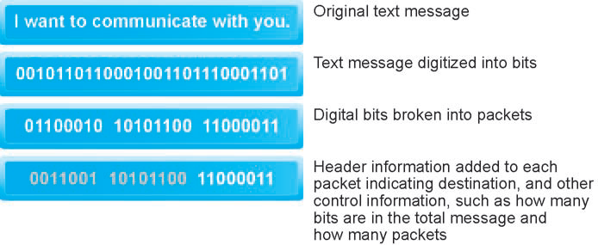
In packet switching, digital messages are divided into fixed-length packets of bits (generally about 1,500 bytes).
Header information indicates both the origin and the ultimate destination address of the packet, the size of the message, and the number of packets the receiving node should expect

Slide 8
Packet Switching
In packet-switched networks, messages are first broken down into packets. Appended to each packet are digital codes that indicate a source address (the origination point) and a destination address, as well as sequencing information and error control information for the packet.
Rather than being sent directly to the destination address, in a packet network, the packets travel from computer to computer until they reach their destination. These computers are called routers.

Slide 9
Packet Switching
A router is a special purpose computer that interconnects the different computer networks that make up the Internet and routes packets along to their ultimate destination as they travel.
To ensure that packets take the best available path toward their destination, routers use a computer program called a routing algorithm.
Packet switching does not require a dedicated circuit, but can make use of any spare capacity that is available on any of several hundred circuits. Packet switching makes nearly full use of almost all available communication lines and capacity.
Moreover, if some lines are disabled or too busy, the packets can be sent on any available line that eventually leads to the destination point.

Slide 10
Universal Protocol - TCP
While packet switching was an enormous advance in communications capacity, there was no universally agreed-upon method for breaking up digital messages into packets, routing them to the proper address, and then reassembling them into a coherent message.
This was like having a system for producing stamps but no postal system (a series of post offices and a set of addresses).
The answer was to develop a protocol (a set of rules and standards for data transfer) to govern the formatting, ordering, compressing, and error-checking of messages, as well as specify the speed of transmission and means by which devices on the network will indicate they have stopped sending and/or receiving messages.

Slide 11
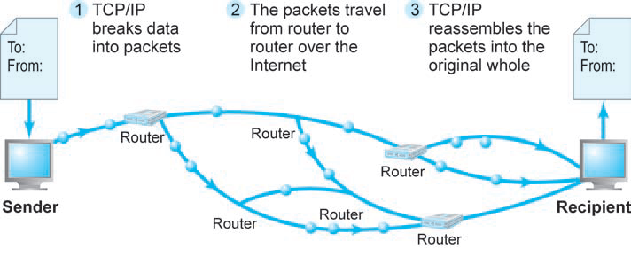
TCP/IP

Slide 12
TCP/IP
TCP
Protocol that establishes the connections among sending and receiving Web computers and handles the assembly of packets at the point of transmission, and their reassembly at the receiving end.
IP
Protocol that provides the Internet’s address in scheme and is responsible for the actual delivery of the packets.

Slide 13
TCP
TCP/IP is divided into four separate layers, with each layer handling a different aspect of the communication problem:

Slide 14
IP
There are two versions of IP currently in use: IPv4 and IPv6. An IPv4 Internet address is a 32-bit number that appears as a series of four separate numbers marked off by periods, such as 64.49.254.91. Each of the four numbers can range from 0–255.
Because many large corporate and government domains have been given millions of IP addresses each (to accommodate their current and future work forces), and with all the new networks and new Internet-enabled devices requiring unique IP addresses being attached to the Internet, by 2011, there were only an estimated 76 million IPv4 addresses left, declining at the rate of 1 million per week.
IPv6 was created to address this problem. An IPv6 Internet address is 128 bits, so it can support up to 2128 (3.4×1038) addresses, many more than IPv4.

Slide 15
Domain Name , DNS , URL
Domain name:
IP address expressed in natural language.
Domain Name System(DNS):
system for expressing numeric IP addresses in natural language.
Uniform Resource Locator (URL):
The address used by a Web browser to identify the location of content on the Web.

Slide 16
The Future Internet
Latency Solutions:
One of the challenges of packet switching, where data is divided into chunks and then sent separately to meet again at the destination, is that the Internet does not differentiate between high-priority packets, such as video clips, and those of lower priority, such as self-contained e-mail messages. Because the packets cannot yet be simultaneously reassembled, the result can be distorted audio and video streams.
Differentiated quality of service (diffserv) is a technology that assigns levels of priority to packets based on the type of data being transmitted.

Slide 17
Guaranteed Service Levels and Lower Error Rates
In today’s Internet, there is no service-level guarantee and no way to purchase the right to move data through the Internet at a fixed pace. Today’s Internet promises only “best effort.”
The Internet is democratic—it speeds or slows everyone’s traffic alike.
In the future, it will be possible to purchase the right to move data through the network at a guaranteed speed in return for higher fees.

Slide 18
Declining Costs
As the Internet pipeline is upgraded, the availability of broadband service will expand beyond major metropolitan areas, significantly reducing the cost of access.
Both broadband and wireless service fees are expected to decline as geographic service areas increase, in part due to competition for that business.

Slide 19
The Internet of Things
Internet technology is spreading beyond the desktop, laptop, and tablet computer, and beyond the smartphone, to consumer electronics, electrical appliances, cars, medical devices, utility systems, machines of all types, even clothing—just about anything that can be equipped with sensors that collect data and connect to the Internet.
IoT:
Use of the Internet to connect a wide variety of devices, machines, and sensors.
The Internet of Things builds on a foundation of existing technologies, such as RFID, and is being enabled by the availability of low-cost sensors, the drop in price of data storage, the development of “Big Data” analytics software that can work with trillions of pieces of data, as well as implementation of IPV6, which will allow Internet addresses to be assigned to all of these new devices.

